Slide 1



Downtime Analysis
Security information

Slide 2






Data Science Group A1
Xaysombath
Thongai
Xaiyaseng
Soukkhaphanh
Putthasingha
Oudone

Slide 3




Downtime Analysis
Data Science Goal
Data modelling for Downtime
Predictive site downtime behavior
Predictive Maintenance
Network Management
Assess Situation
Manual Processing
Objectives
Site downtime behavior
Accuracy data Analysis
Cost effectiveness
Problem Statement
Network not reliability
Don’t have tool for downtime analysis

Slide 4
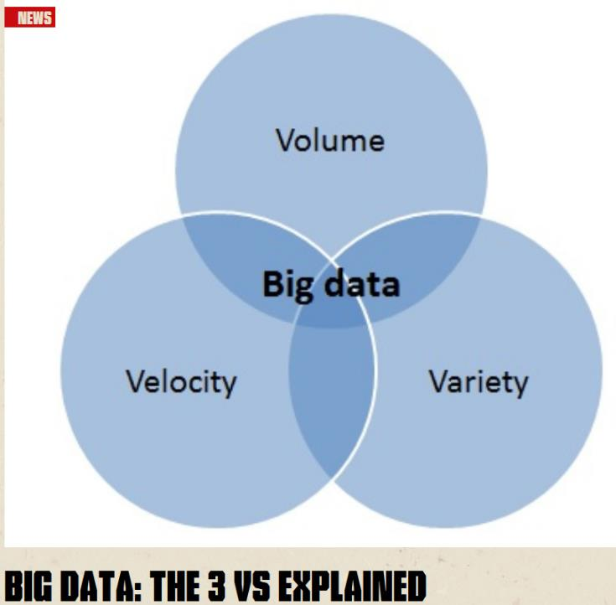

Slide 5
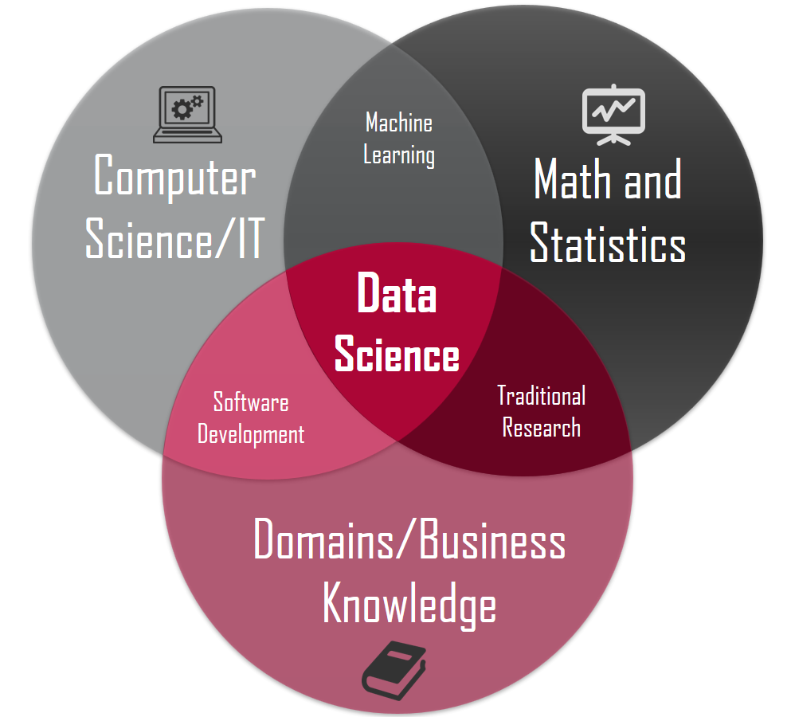

Slide 6
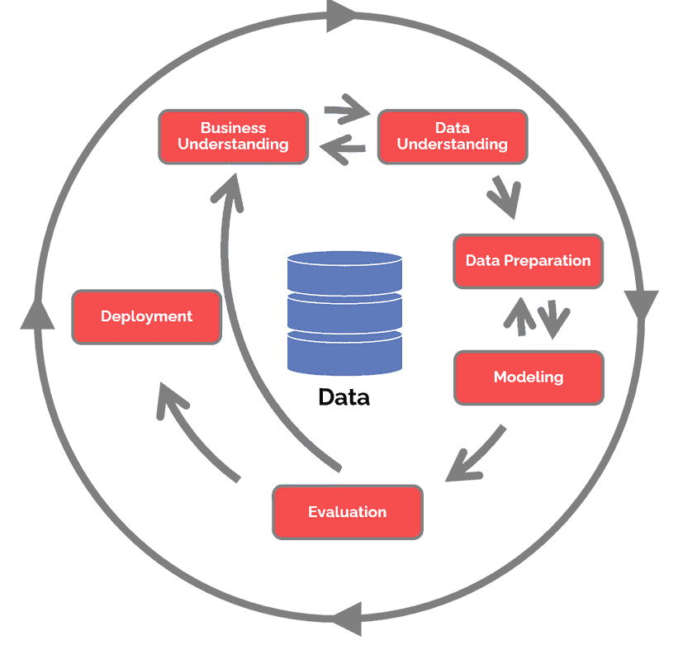
CRISP-DM life cycle

Slide 7
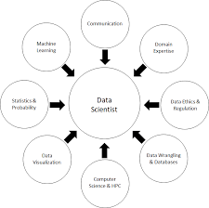
CRISP-DM life cycle

Slide 8
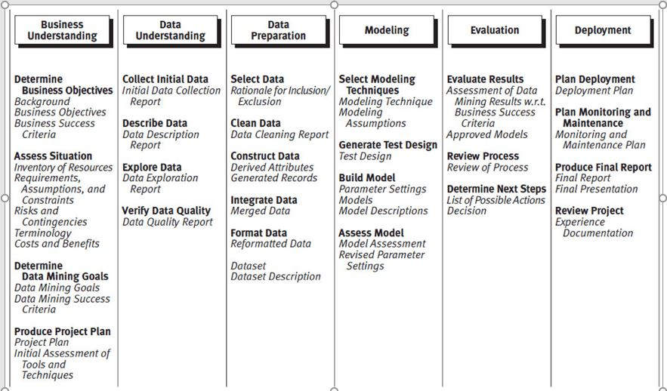
CRISP-DM life cycle

Slide 9
THANKS
Security information

